Slide 1

Segmentation 세그멘테이션
문학준
2022/09/27

Slide 2
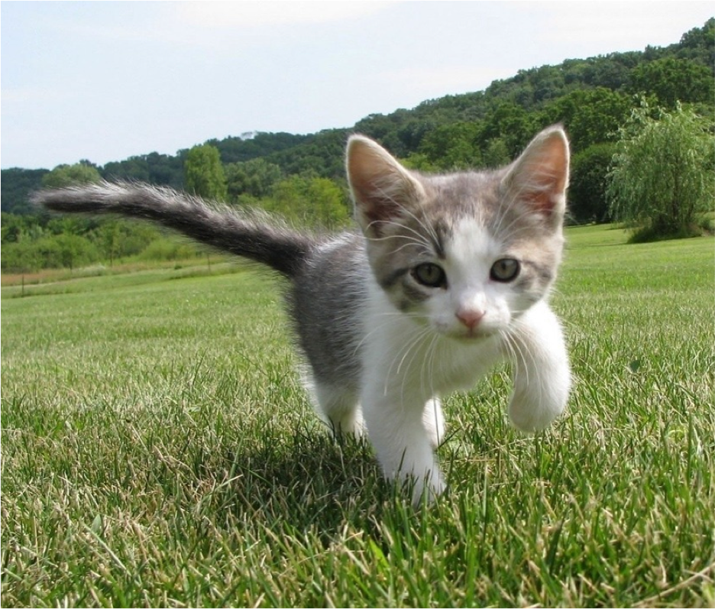
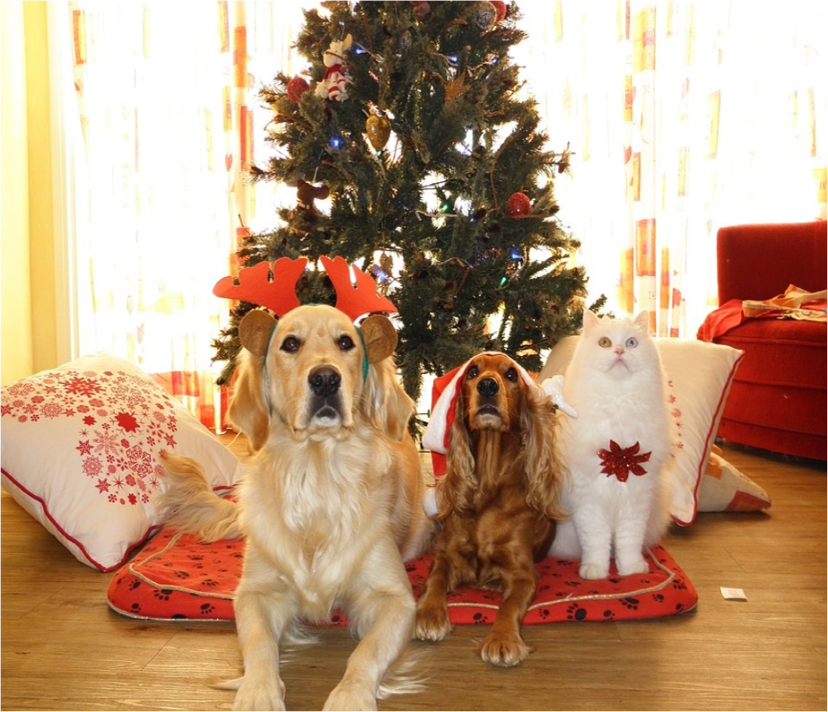
Segmentation
Semantic Segmentation
Instance Segmentation
GRASS, CAT, TREE, SKY
DOG, DOG, CAT

Slide 3
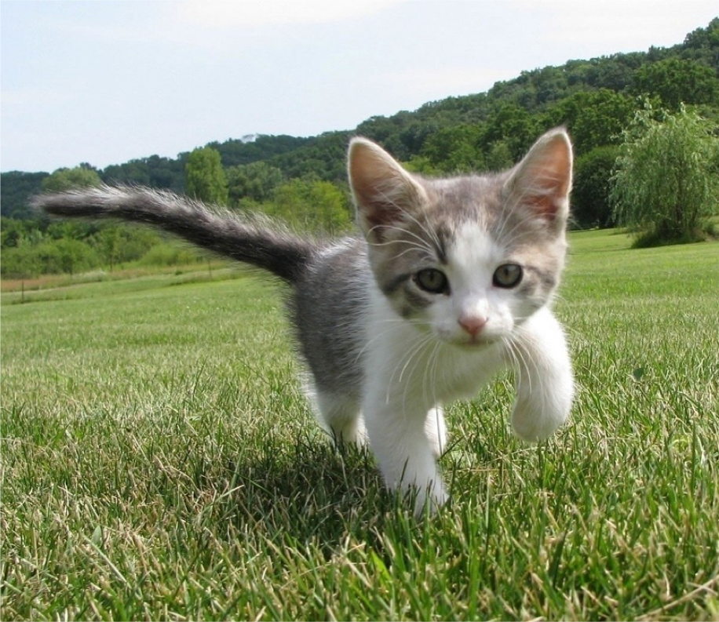
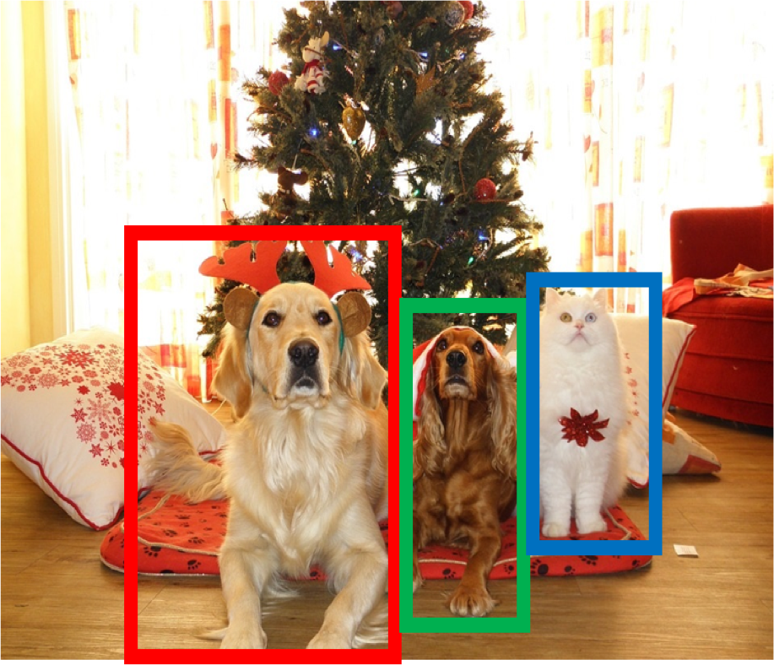
Computer Vision Tasks: Semantic Segmentation
Semantic Segmentation
Object Detection
Instance Segmentation
Classification
CAT
GRASS, CAT, TREE, SKY
DOG, DOG, CAT
DOG, DOG, CAT
객체 없음
객체 없이 픽셀만 구분
여러 개의 객체

Slide 4

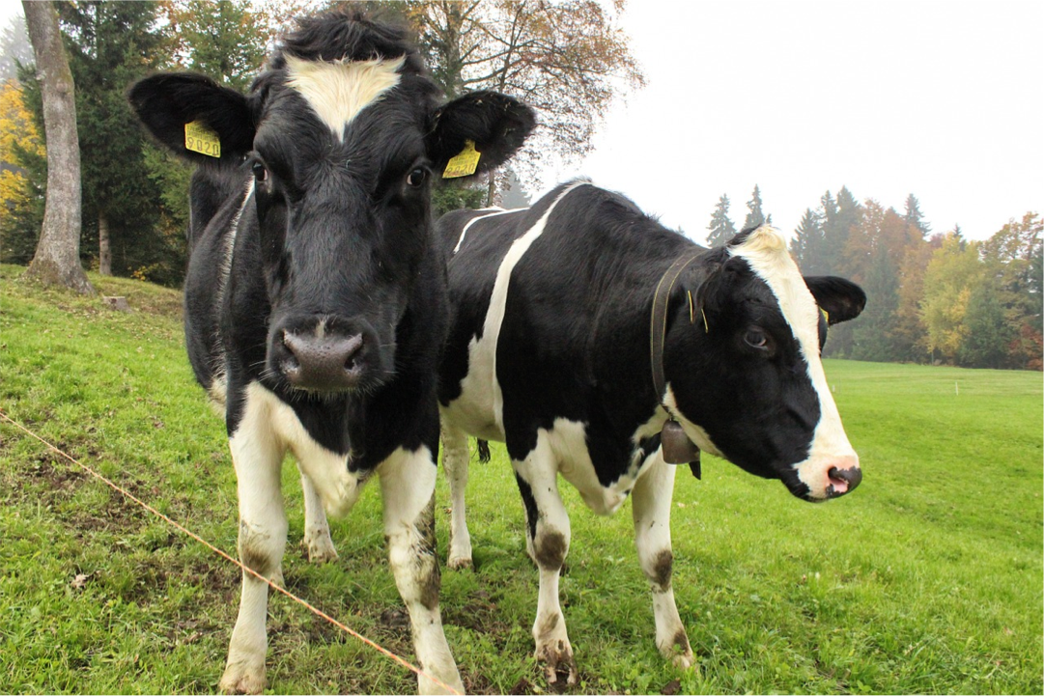
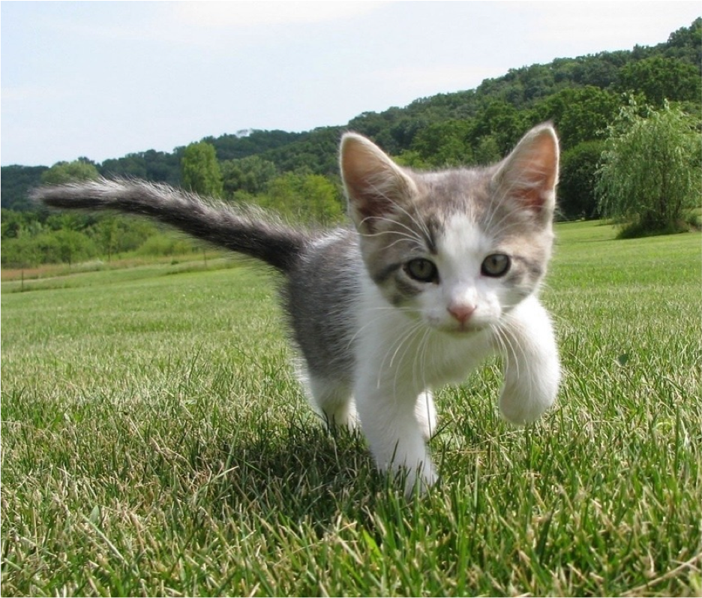
Semantic Segmentation
이미지의 각 픽셀을 라벨링
각 인스턴스를 구분하지는 않고, 픽셀에 대해서만 구분
Sky
Sky
Cow
Grass
Trees
Trees
Cat
Grass
This image is CC0 public domain

Slide 5
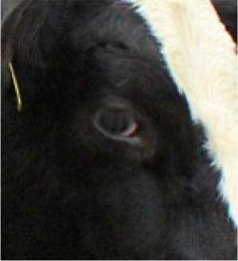
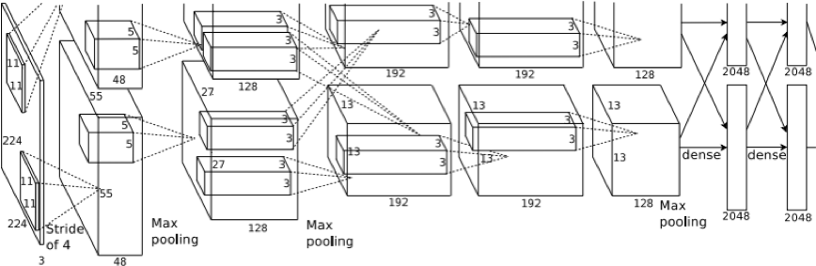
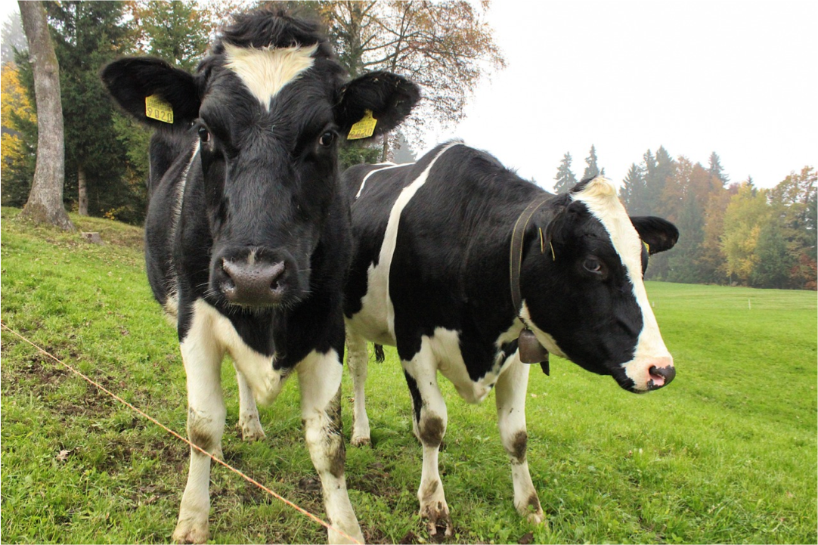

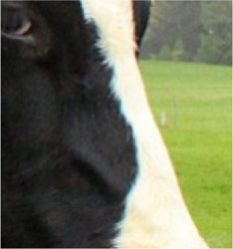
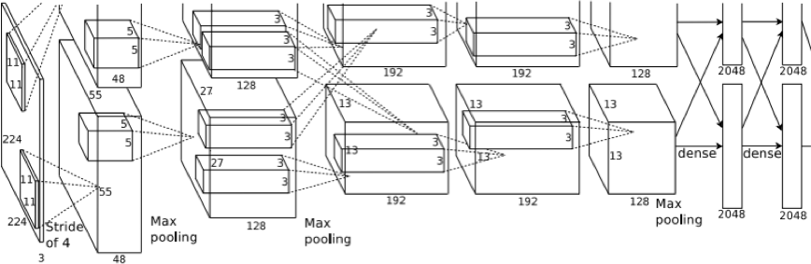

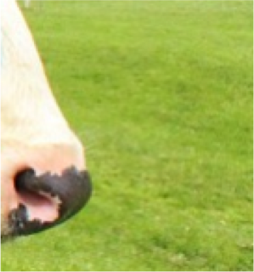
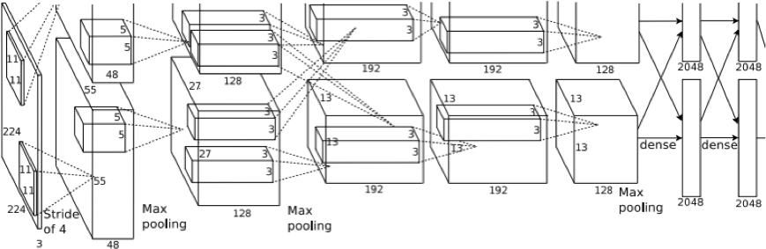

Semantic Segmentation Idea: Sliding Window
이미지 조각
CNN으로 조각의 가운데 픽셀을 분류
전체 이미지
Cow
Cow
Grass
문제점: 매우 비효율적이며 겹치는 조각들 간의 공유된 feature들을 재사용하지 않음
Farabet et al, “Learning Hierarchical Features for Scene Labeling,” TPAMI 2013
Pinheiro and Collobert, “Recurrent Convolutional Neural Networks for Scene Labeling”, ICML 2014

Slide 6
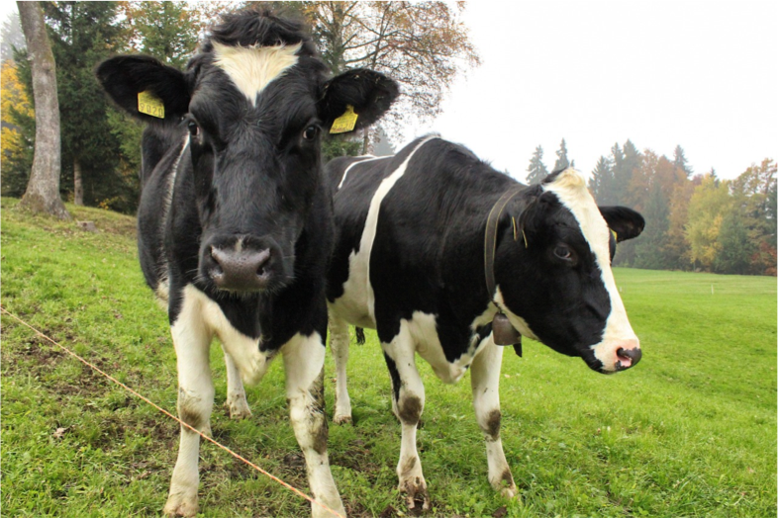
Semantic Segmentation: Fully Convolutional Network
모든 픽셀에 대하여 한번에 예측하기 위하여 여러 convolution 레이어로 구성된 네트워크를 사용
Conv
Conv
Conv
Conv
argmax
Input: 3 x H x W
Scores: C x H x W
Predictions: H x W
Convolutions: D x H x W
Loss function: Per-Pixel cross-entropy
Long et al, “Fully convolutional networks for semantic segmentation”, CVPR 2015
Notes:
컨볼루션 결과 : C * H * W의 텐서
여기에 argmax를 적용하면 입력 이미지와 동일한 크기의 Segmentation 결과(prediction)이 나옴.

Slide 7
Semantic Segmentation: Fully Convolutional Network
모든 픽셀에 대하여 한번에 예측하기 위하여 여러 convolution 레이어로 구성된 네트워크를 사용
Conv
Conv
Conv
Conv
argmax
Input: 3 x H x W
Problem #1: 큰 receptive field를 위해서 layer 수가 많이 필요함
Problem #2: 고해상도의 이미지에 대해 convolution 연산의 비용이 매우 높음
Long et al, “Fully convolutional networks for semantic segmentation”, CVPR 2015
Notes:
모든 픽셀마다 라벨링 작업이 필요하므로 매우 시간이 오래 걸린다.
receptive field란 출력 레이어의 뉴런 하나에 영향을 미치는 입력 뉴런들의 공간 크기이다.
예를 들면 3x3 컨볼루션 연산 두번의 receptive field는
5x5 컨볼루션 연산 두번의 receptive field의 크기와 같다

Slide 8
Semantic Segmentation: Fully Convolutional Network
Downsampling: Pooling, strided convolution
연산 비용을 줄이기 위해 신경망 안에 downsampling 과 upsampling 을 포함시킨다.
Upsampling:
???
Med-res: D₂ x H/4 x W/4
Med-res: D₂ x H/4 x W/4
Low-res:
D₃ x H/4 x W/4
Input: 3 x H x W
High-res: D₁ x H/2 x W/2
High-res: D₁ x H/2 x W/2
Predictions: H x W
Notes:
downsampling을 함으로써 앞서 말했던 1, 2 번 문제들을 해결하게 된다.
downsampling은 예전에 많이 이야기한 것이지만, 이제 upsampling의 몇가지 기법에 대해서 알아볼 것이다.

Slide 9
In-Network Upsampling: “Unpooling”
Bed of Nails Nearest Neighbor
1 | 0 | 2 | 0
0 | 0 | 0 | 0
3 | 0 | 4 | 0
0 | 0 | 0 | 0
1 | 1 | 2 | 2
1 | 1 | 2 | 2
3 | 3 | 4 | 4
3 | 3 | 4 | 4
1 | 2
3 | 4
1 | 2
3 | 4
Input C x 2 x 2
Output C x 4 x 4
Input C x 2 x 2
Output C x 4 x 4
Notes:
downsampling을 pooling이라고 부르기 때문에 upsampling은 unpooling 이라고도 불린다.

Slide 10


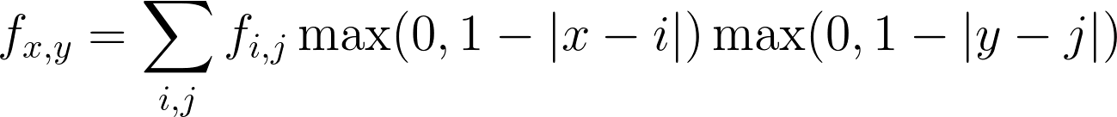
In-Network Upsampling: Bilinear Interpolation
1.00 | 1.25 | 1.75 | 2.00
1.50 | 1.75 | 2.25 | 2.50
2.50 | 2.75 | 3.25 | 3.50
3.00 | 3.25 | 3.75 | 4.00
1 | 2
3 | 4
Input: C x 2 x 2
Output: C x 4 x 4
Use two closest neighbors in x and y to construct linear approximations
Notes:
bilinear interpolation(이중 선형 보간법)
직사각형의 네 꼭지점에서의 값이 주어져 있을 때, 이 사각형의 변 및 내부의 임의의 점에서의 값을 추정하는 방법

Slide 11
In-Network Upsampling: Bicubic Interpolation
0.68 | 1.02 | 1.56 | 1.89
1.35 | 1.68 | 2.23 | 2.56
2.44 | 2.77 | 3.32 | 3.65
3.11 | 3.44 | 3.98 | 4.32
1 | 2
3 | 4
Input: C x 2 x 2 Output: C x 4 x 4
Use three closest neighbors in x and y to construct cubic approximations
(This is how we normally resize images!)

Slide 12
In-Network Upsampling: “Max Unpooling”
Max Pooling: Remember which position had the max
Max Unpooling: Place into remembered positions
1 | 2 | 6 | 3
3 | 5 | 2 | 1
1 | 2 | 2 | 1
7 | 3 | 4 | 8
0 | 0 | 2 | 0
0 | 1 | 0 | 0
0 | 0 | 0 | 0
3 | 0 | 0 | 4
5 | 6
7 | 8
Rest of net
Pair each downsampling layer with an upsampling layer
1 | 2
3 | 4
Noh et al, “Learning Deconvolution Network for Semantic Segmentation”, ICCV 2015
Notes:
Pooling 방법에 따라 다른 unpooling 방법을 택할 것
-> avgpool 일 경우 bed of nails, nearest neighbor, bilinear/bicubic

Slide 13
Learnable Upsampling: Transposed Convolution
3 x 3 convolution transpose, stride 2
Input: 2 x 2
Output: 4 x 4
Notes:
Transposed convolution은 합성곱 연산(convolution)의 역연산

Slide 14
Learnable Upsampling: Transposed Convolution
3 x 3 convolution transpose, stride 2
Weight filter by input value and copy to output
Input: 2 x 2
Output: 4 x 4

Slide 15
Learnable Upsampling: Transposed Convolution
3 x 3 convolution transpose, stride 2
Filter moves 2 pixels in output for every 1 pixel in input
Weight filter by input value and copy to output
Input: 2 x 2
Output: 4 x 4

Slide 16
Learnable Upsampling: Transposed Convolution
Sum where
3 x 3 convolution transpose, stride 2
output overlaps
Filter moves 2 pixels in output for every 1 pixel in input
Weight filter by input value and copy to output
Input: 2 x 2
Output: 4 x 4

Slide 17
Learnable Upsampling: Transposed Convolution
Sum where
3 x 3 convolution transpose, stride 2
output overlaps
This gives 5x5 output – need to trim one pixel from top and left to give 4x4 output
Weight filter by input value and copy to output
Input: 2 x 2
Output: 4 x 4
Notes:
각 필터와 input을 곱해서 5x5로 만들고 위쪽과 왼쪽의 남는 부분은 없앤다

Slide 18
Transposed Convolution: 1D example
Input Filter Output
Output has copies of filter weighted by input
ax
ay
az
 | + | bx
 |  | by
 |  | bz
x
y
z
a
Stride 2: Move 2 pixels output for each pixel in input
b
Sum at overlaps

Slide 19
Transposed Convolution: 1D example
Input Filter Output
This has many names:
ax
ay
az
 | + | bx
 |  | by
 |  | bz
Deconvolution (bad)!
Upconvolution
Fractionally strided convolution
Backward strided convolution
Transposed Convolution (best name)
x
y
z
a
b

Slide 20
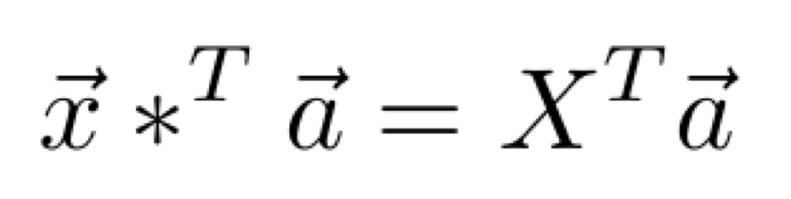
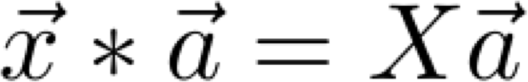
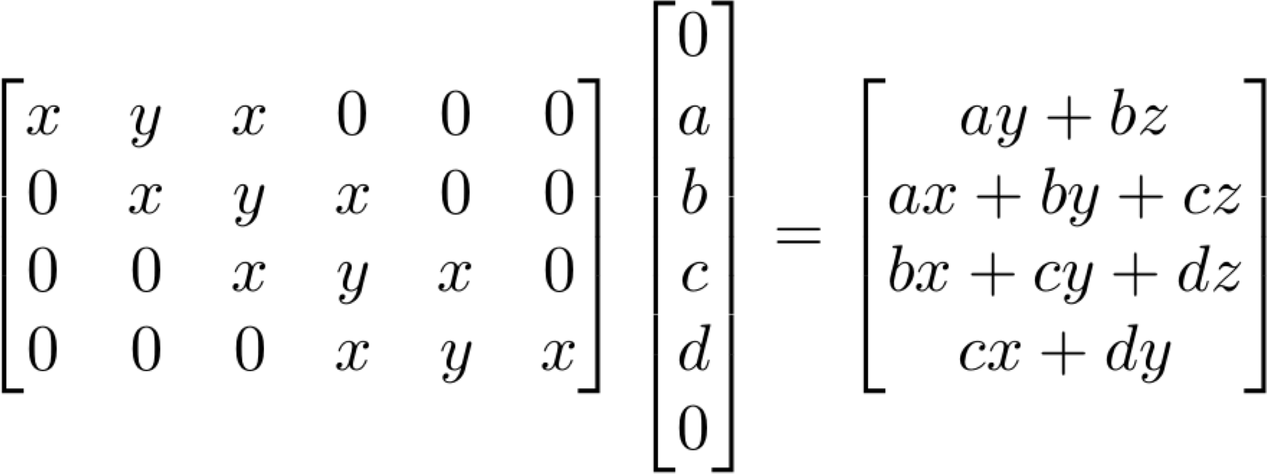
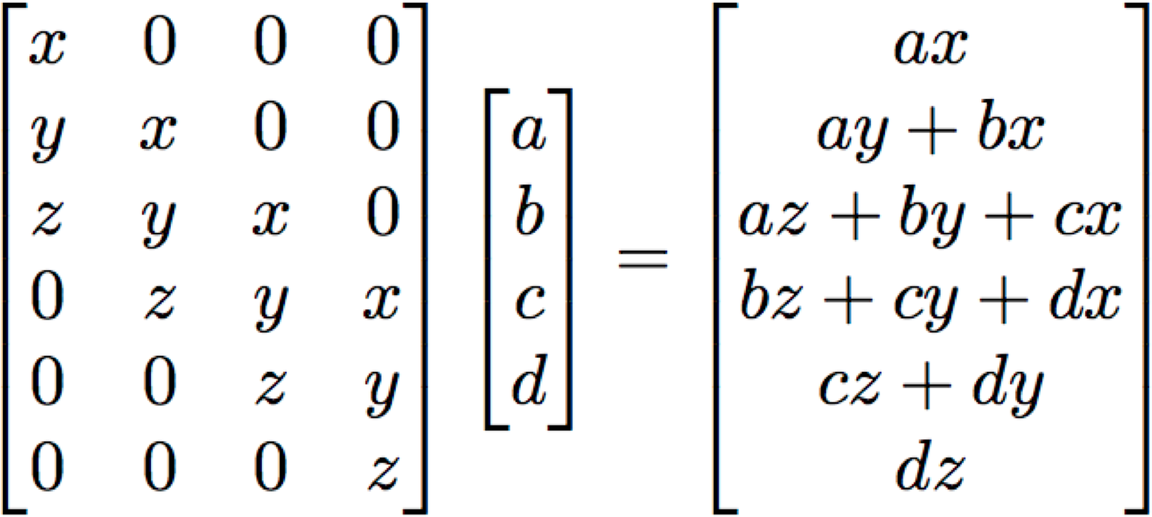
Convolution as Matrix Multiplication (1D Example)
We can express convolution in terms of a matrix multiplication
Transposed convolution multiplies by the transpose of the same matrix:
Example: 1D conv, kernel size=3, stride=1, padding=1
stride>1 일 때, transposed convolution 은 일반적인 convolution이다. (padding rule은 다름)

Slide 21
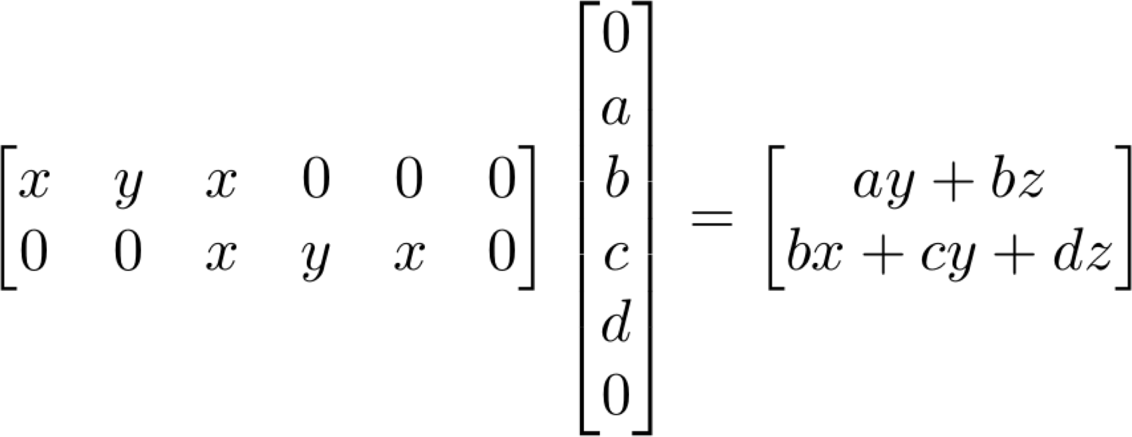
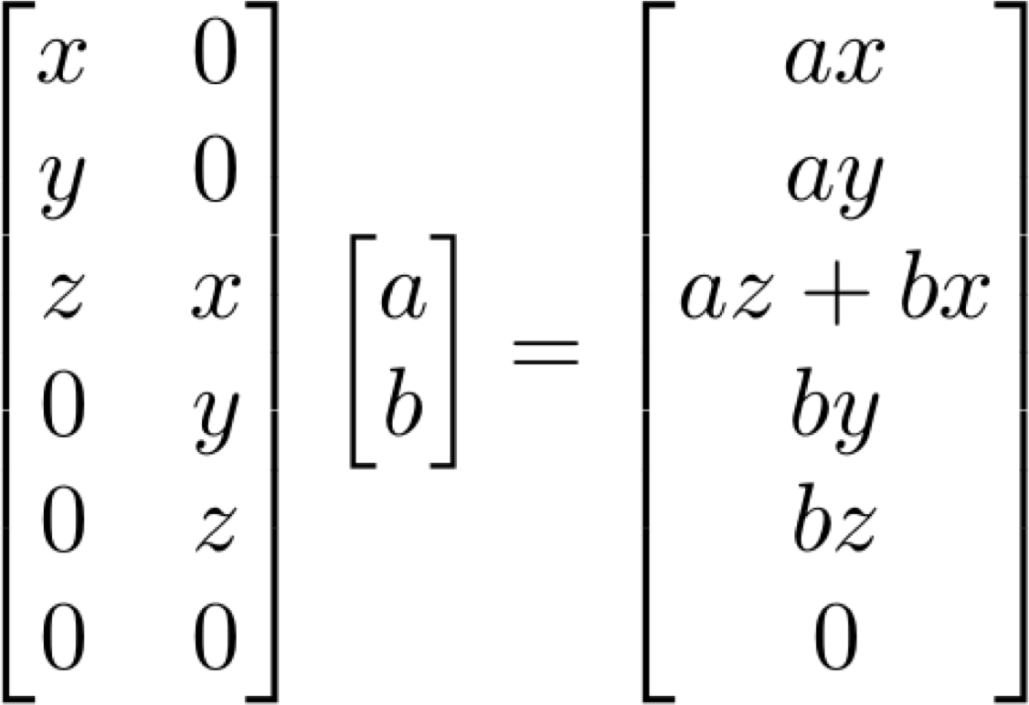
Convolution as Matrix Multiplication (1D Example)
We can express convolution in terms of a matrix multiplication
Transposed convolution multiplies by the transpose of the same matrix:
Example: 1D conv, kernel size=3, stride=2, padding=1
stride>1 일 때, transposed convolution 은 normal convolution으로 나타날 수 없다.

Slide 22
Semantic Segmentation: Fully Convolutional Network
Design network as a bunch of convolutional layers, with
downsampling and upsampling inside the network!
Upsampling: Iinterpolation, transposed conv
Downsampling: Pooling, strided convolution
Med-res: D₂ x H/4 x W/4
Med-res: D₂ x H/4 x W/4
Low-res:
D₃ x H/4 x W/4
Input: 3 x H x W
High-res: D₁ x H/2 x W/2
High-res: D₁ x H/2 x W/2
Predictions: H x W
Loss function: Per-Pixel cross-entropy

Slide 23
Things and Stuff
Things: 객체로 분류될 수 있는 카테고리
(e.g. cats, cars, person)
Stuff: (주로 배경으로 분류되며) 객체로는 분류되지 않는 카테고리
(e.g. sky, grass, water, trees)
Sky
Sky
Cow
Grass
Trees
Trees
Cat
Grass
This image is CC0 public domain

Slide 24

Computer Vision Tasks
Object Detection: 객체를 분류하고 박스로 구분 (Only things)
Semantic Segmentation: 픽셀마다 라벨링을 하지만, 객체를 서로 구분하지는 않음 (Both things and stuff)
Sky
Cow
Grass
Trees

Slide 25
Computer Vision Tasks: Instance Segmentation
Semantic Segmentation
Object Detection
Instance Segmentation
Classification
CAT
GRASS, CAT, TREE, SKY
DOG, DOG, CAT
DOG, DOG, CAT
No spatial extent
No objects, just pixels
Multiple Objects

Slide 26
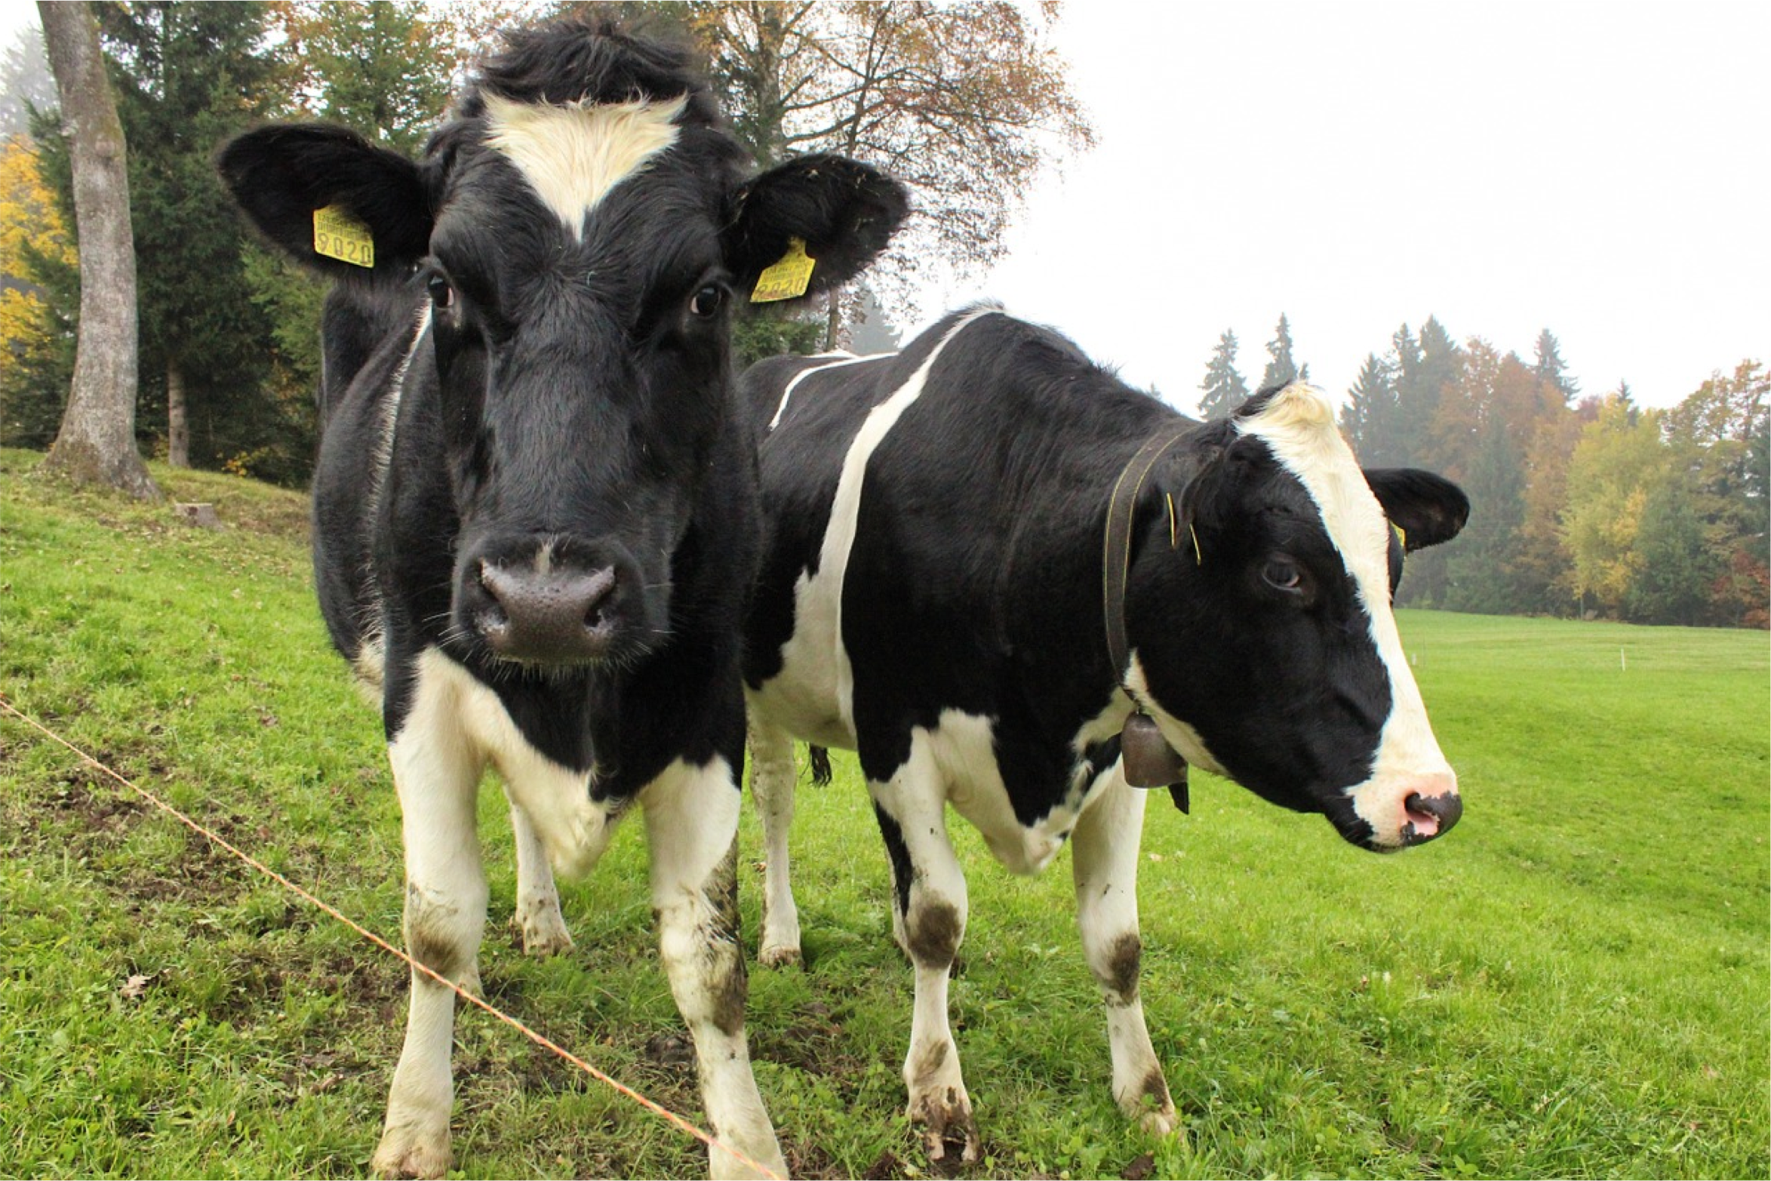
Computer Vision Tasks: Instance Segmentation
Instance Segmentation:
Cow
Detect all objects in the image, and identify the pixels that belong to each object (Only things!)
Cow
Approach: Perform object detection, then predict a segmentation mask for each object!

Slide 27
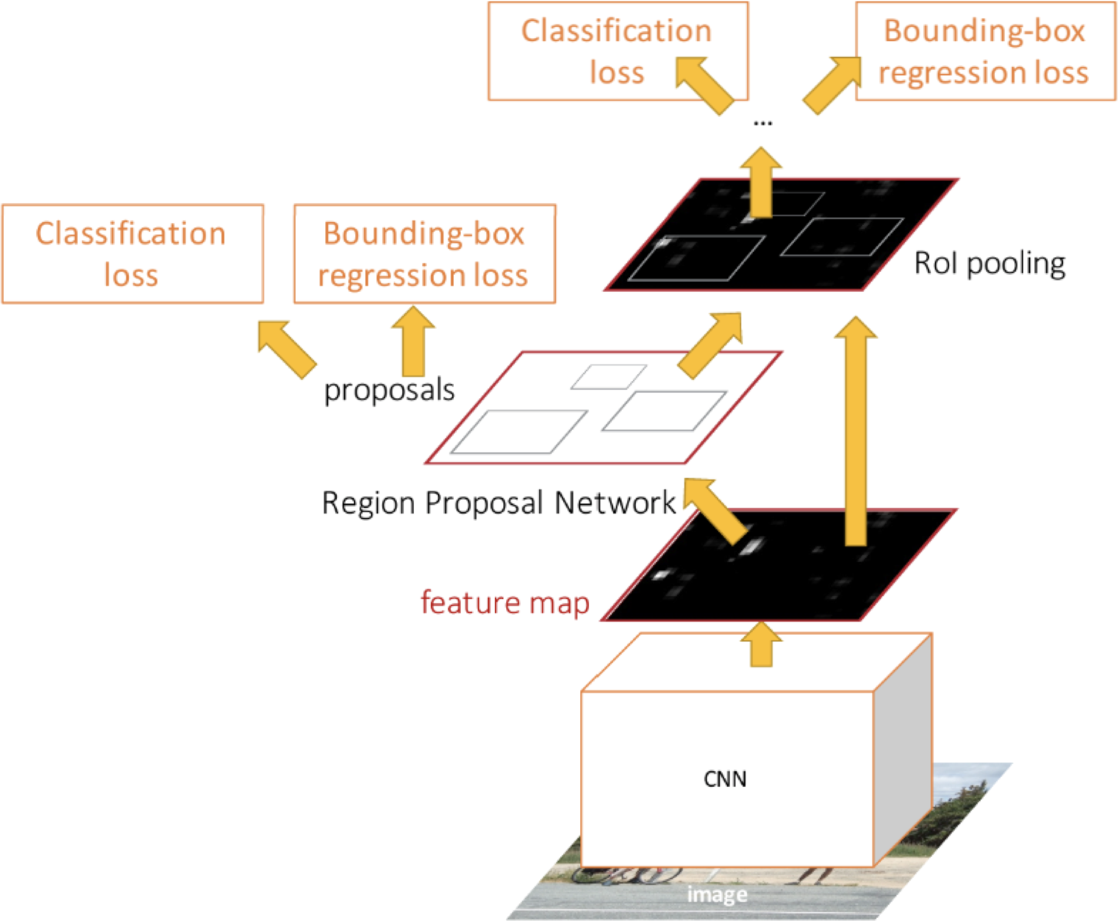
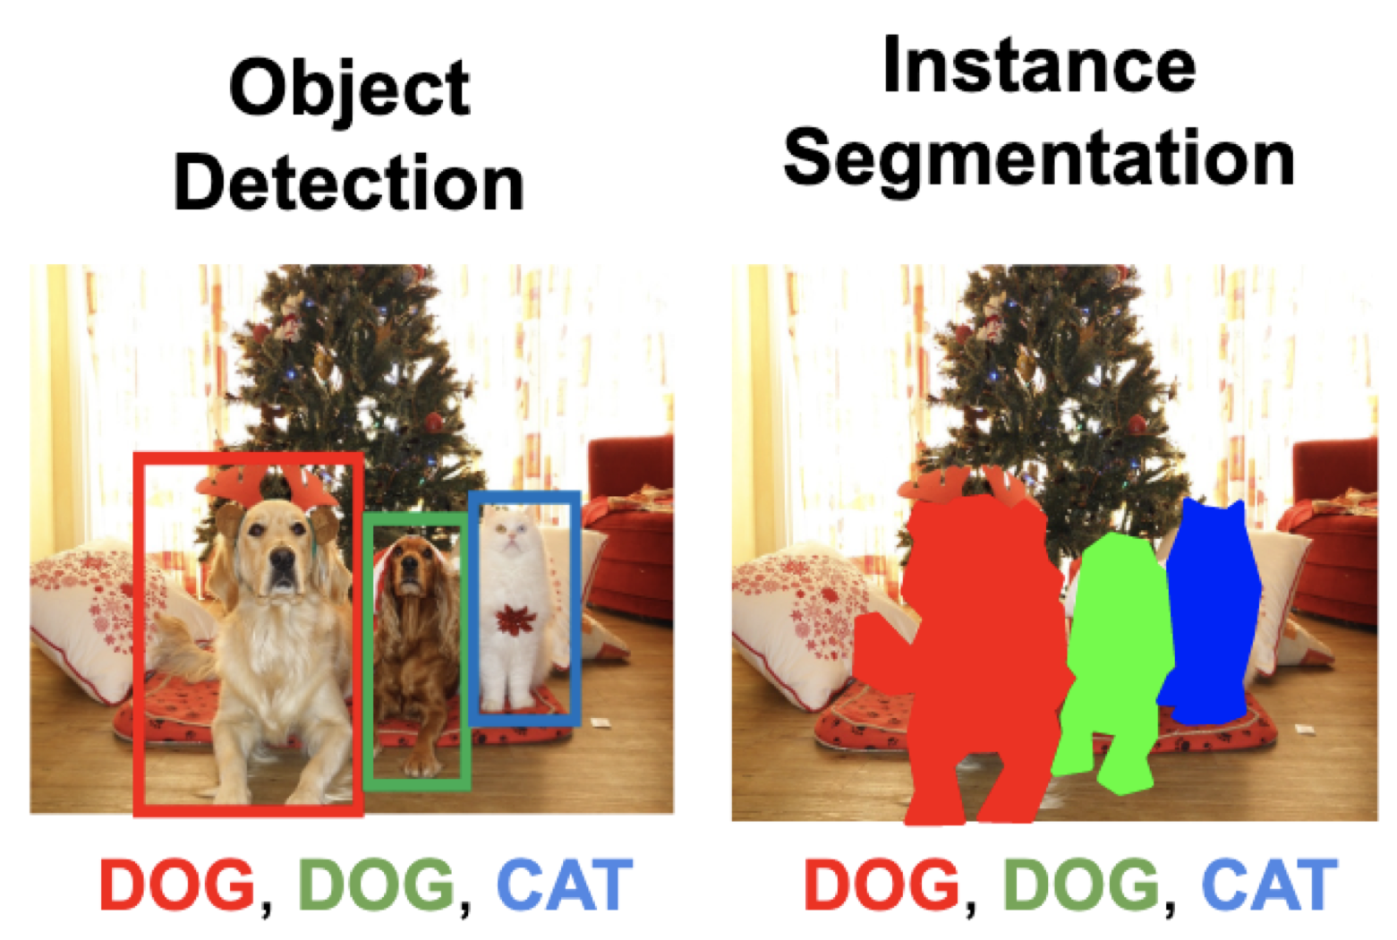
Instance Segmentation: Mask R-CNN
Mask Prediction
Notes:
Detection 된 상태에서 segmentation mask를 예측하는 작업

Slide 28
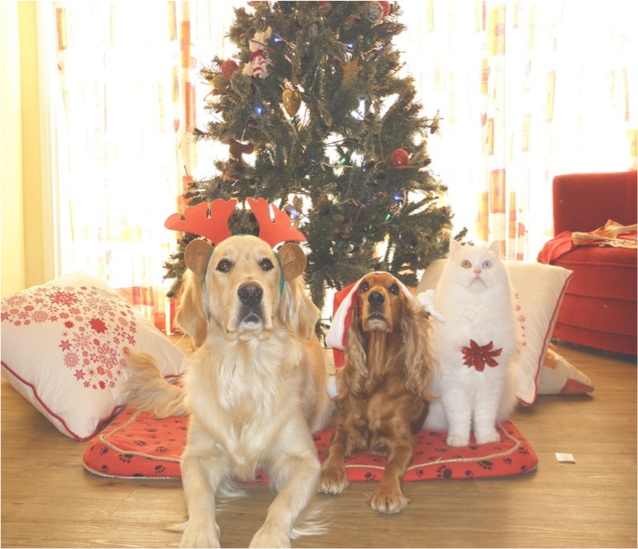
Mask R-CNN
Classification Scores: C
Box coordinates (per class): 4 * C
CNN
+RPN
Conv Conv
256 x 14 x 14
RoI Align
256 x 14 x 14

Slide 29
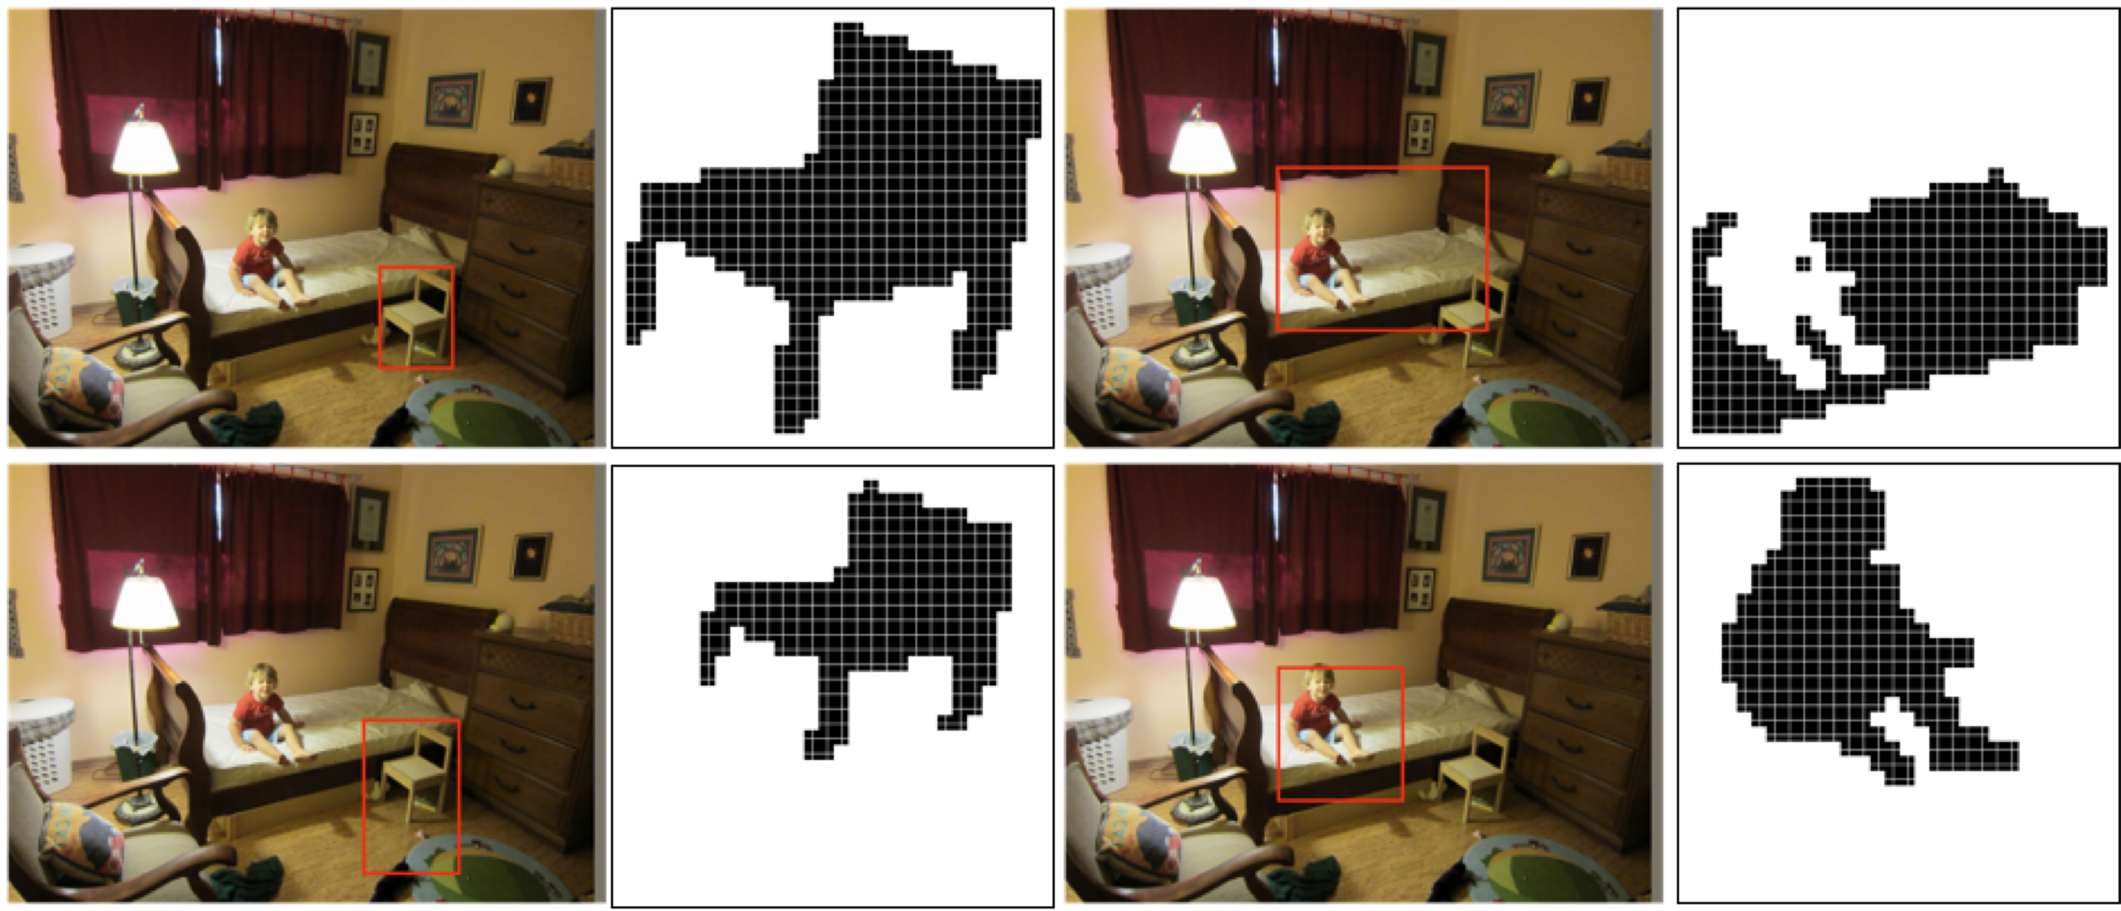
Mask R-CNN: Example Training Targets
Notes:
의자, 침대, 사람에 대하여 segmentation mask를 생성한 경우.
의자 : detection이 달라지면 mask도 달라지는 것을 보여줌.

Slide 30
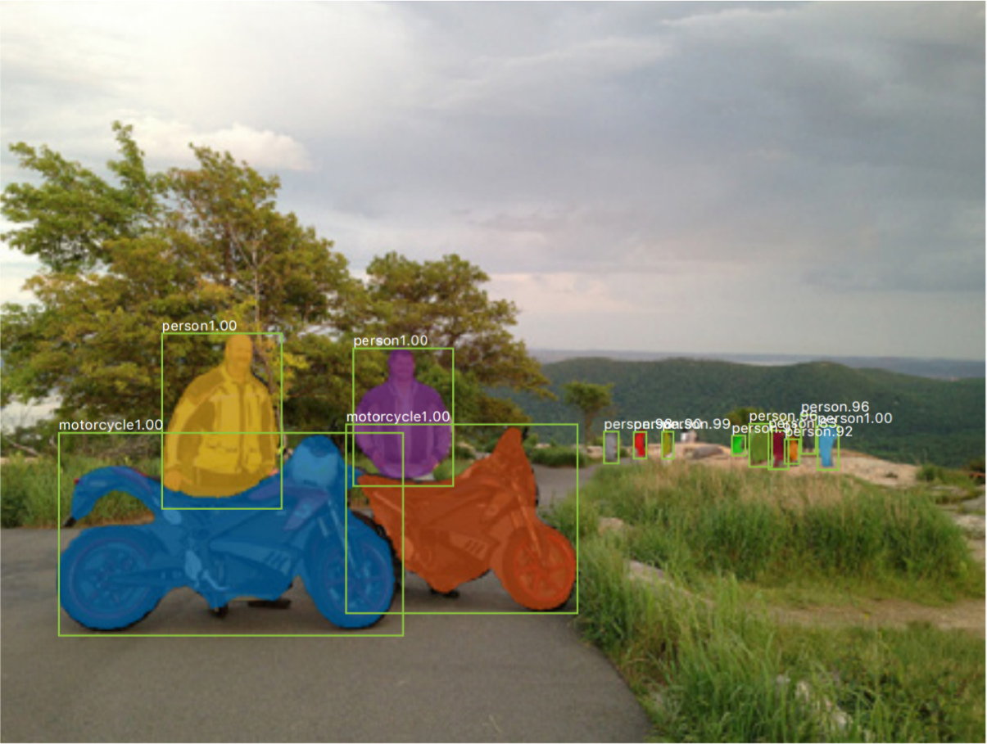
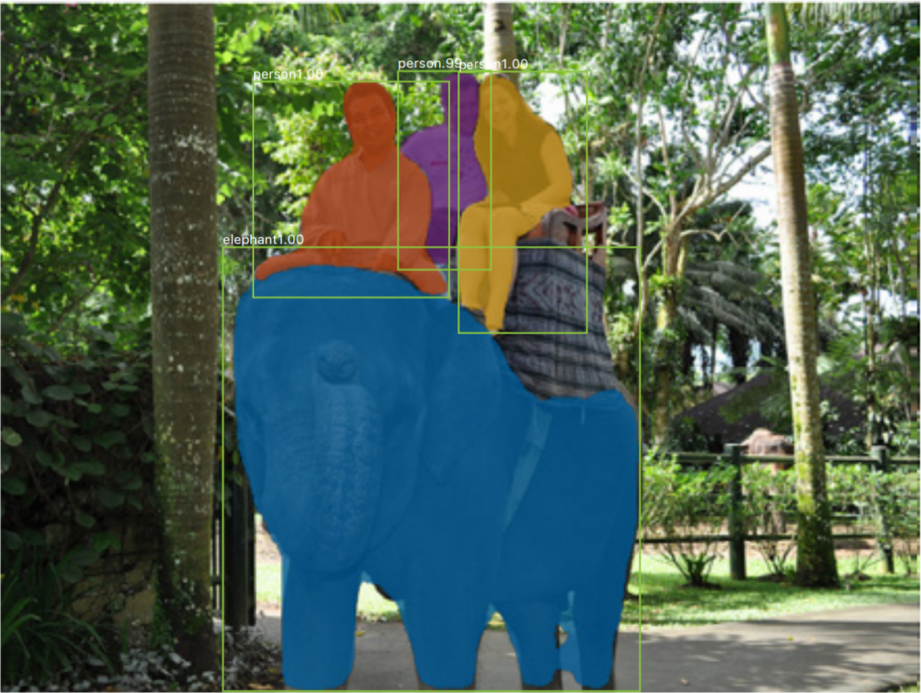
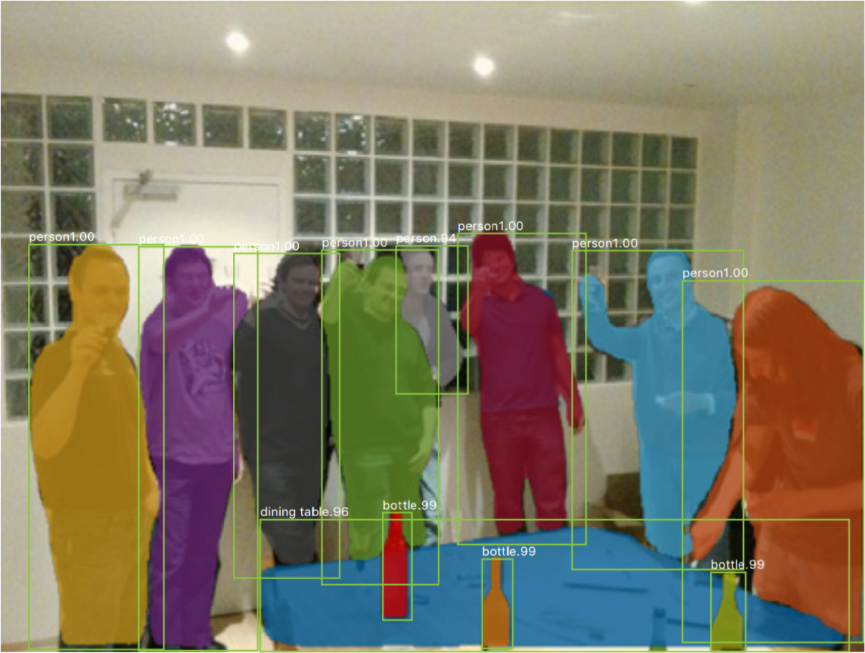
Mask R-CNN: Very Good Results!

Slide 31

Beyond Instance Segmentation: Panoptic Segmentation
Label all pixels in the image (both things and stuff)
Sky
Trees
Cow #1
Cow #1
For “thing” categories also separate into instances
Cow #2
Grass
Kirillov et al, “Panoptic Segmentation”, CVPR 2019
Kirillov et al, “Panoptic Feature Pyramid Networks”, CVPR 2019

Slide 32
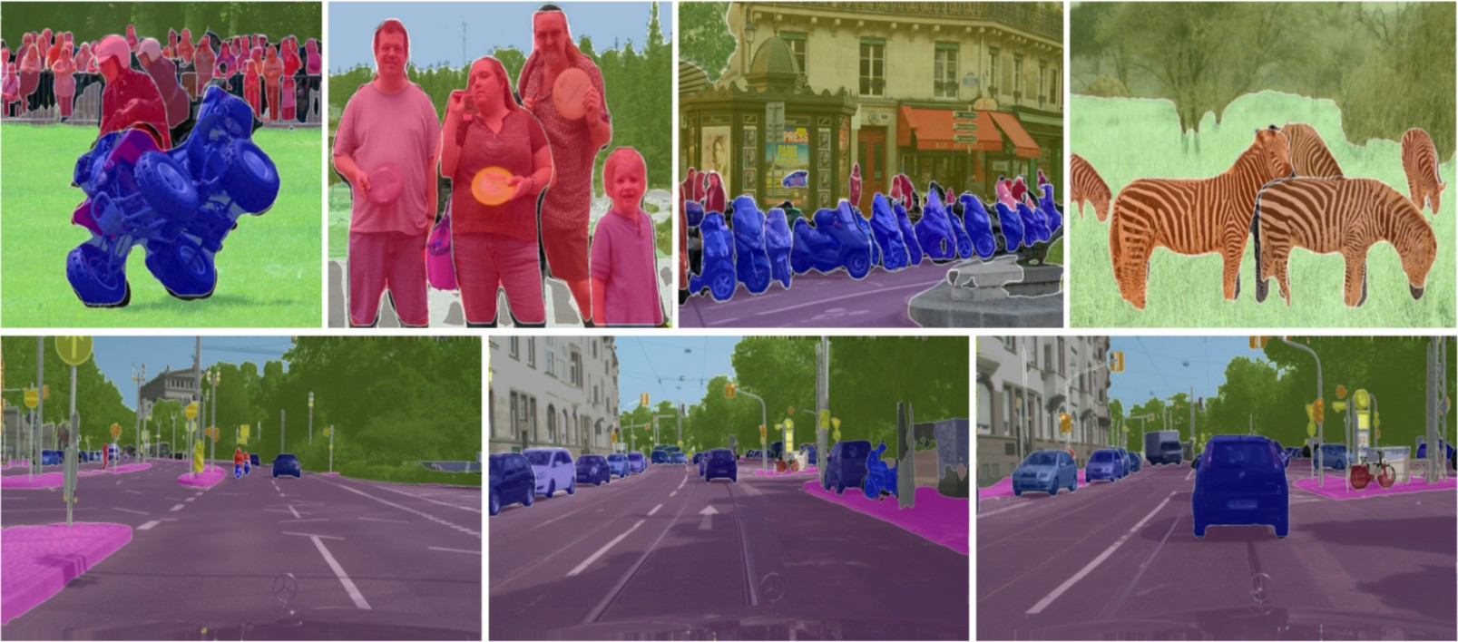
Beyond Instance Segmentation: Panoptic Segmentation
Kirillov et al, “Panoptic Feature Pyramid Networks”, CVPR 2019

Slide 33
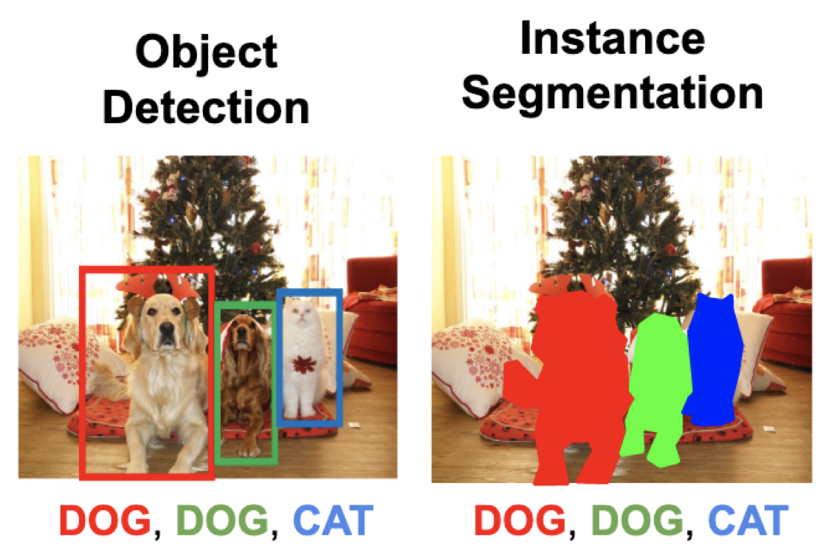

Mask R-CNN: Keypoint Estimation
Mask Prediction
Keypoint prediction
Keypoint estimation

Slide 34
Mask R-CNN: Keypoints
Classification Scores: C
Box coordinates (per class): 4 * C Segmentation mask: C x 28 x 28
One mask for each of the K different keypoints
Left ankle Right ankle
…
CNN
+RPN
Conv…
RoI Align
Keypoint masks: K x 56 x 56
Ground-truth has one “pixel” turned on per keypoint. Train with softmax loss
256 x 14 x 14
He et al, “Mask R-CNN”, ICCV 2017

Slide 35
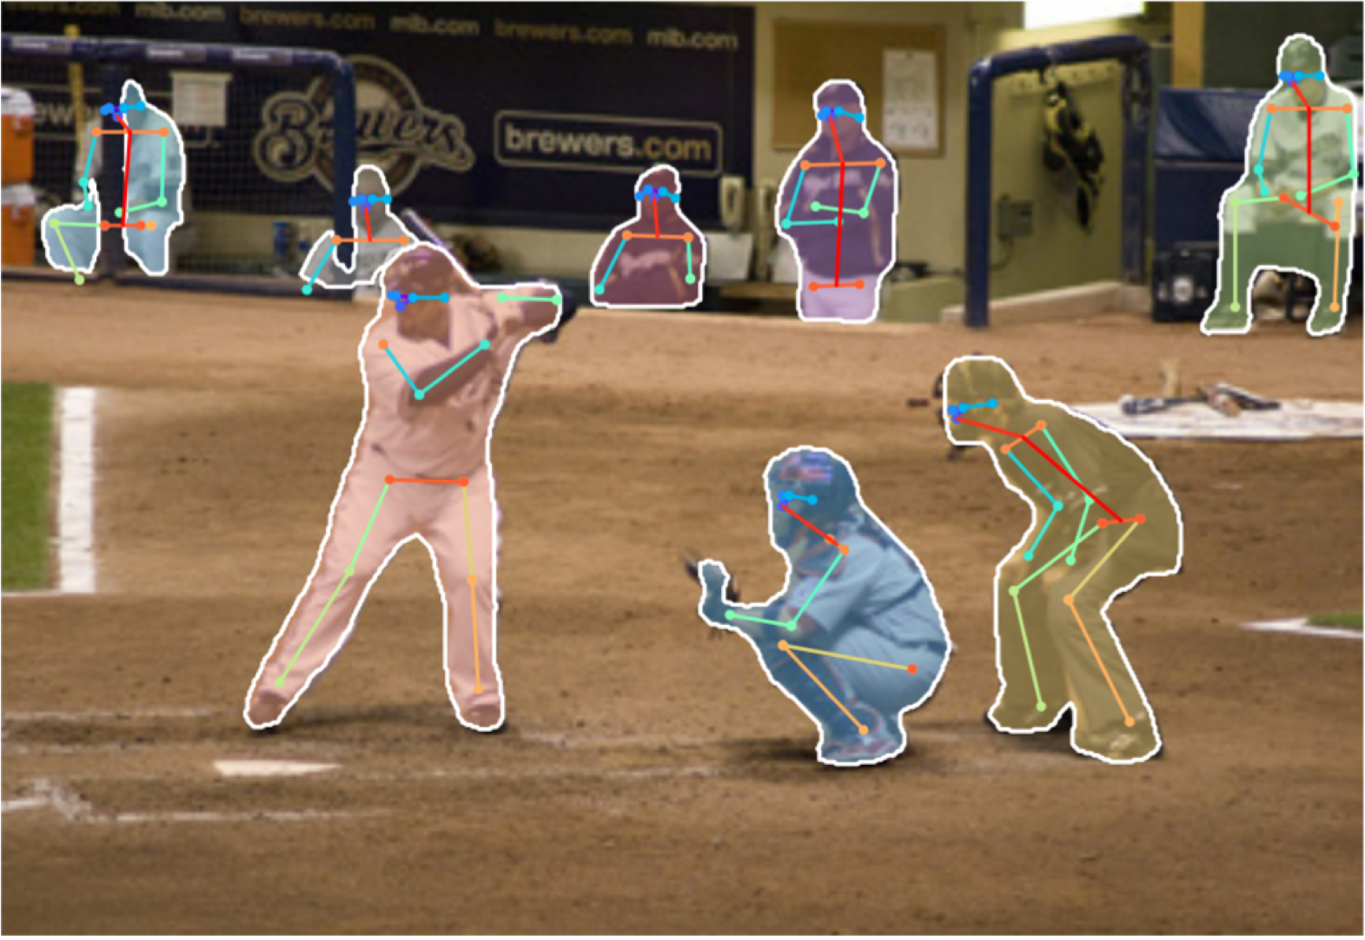
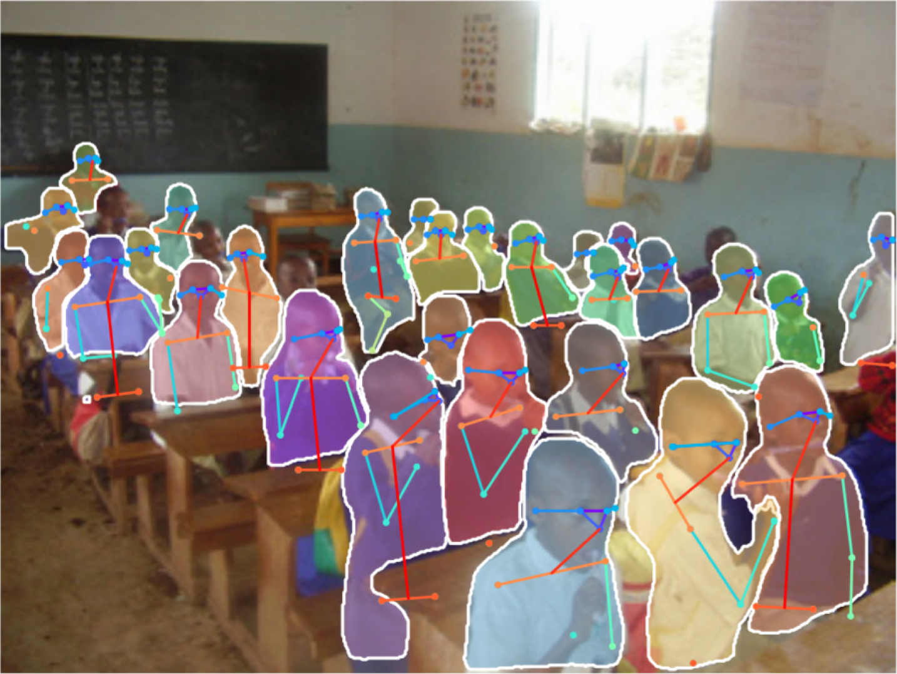
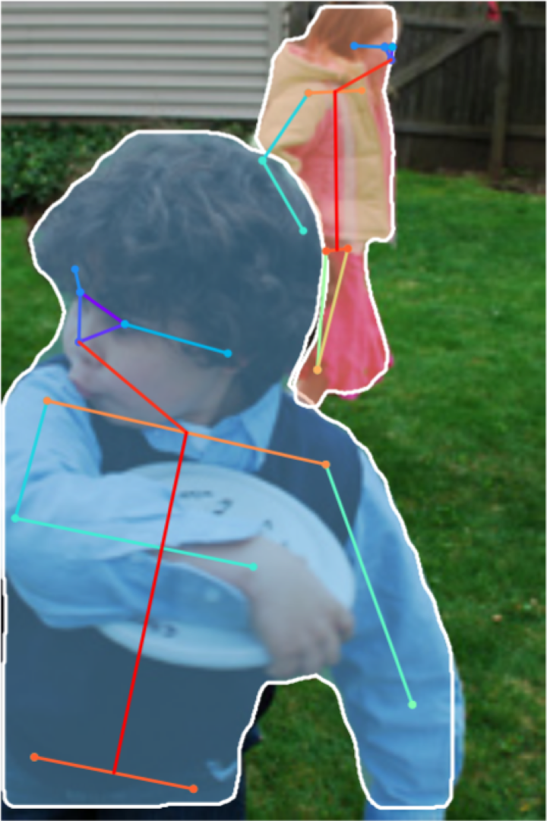
Joint Instance Segmentation and Pose Estimation

Slide 36
General Idea: Add Per- Region “Heads” to Faster / Mask R-CNN!
Mask Prediction
Keypoint prediction
Per-Region Heads:
Each receives the features after
RoI Pool / RoI Align, makes some prediction per-region
Keypoint estimation

Slide 37
Dense Captioning: Predict a caption per region!
Caption prediction (LSTM)
Per-Region Heads:
Each receives the features after
RoI Pool / RoI Align, makes some prediction per-region
Johnson, Karpathy, and Fei-Fei, “DenseCap: Fully Convolutional
Localization Networks for Dense Captioning”, CVPR 2016

Slide 38
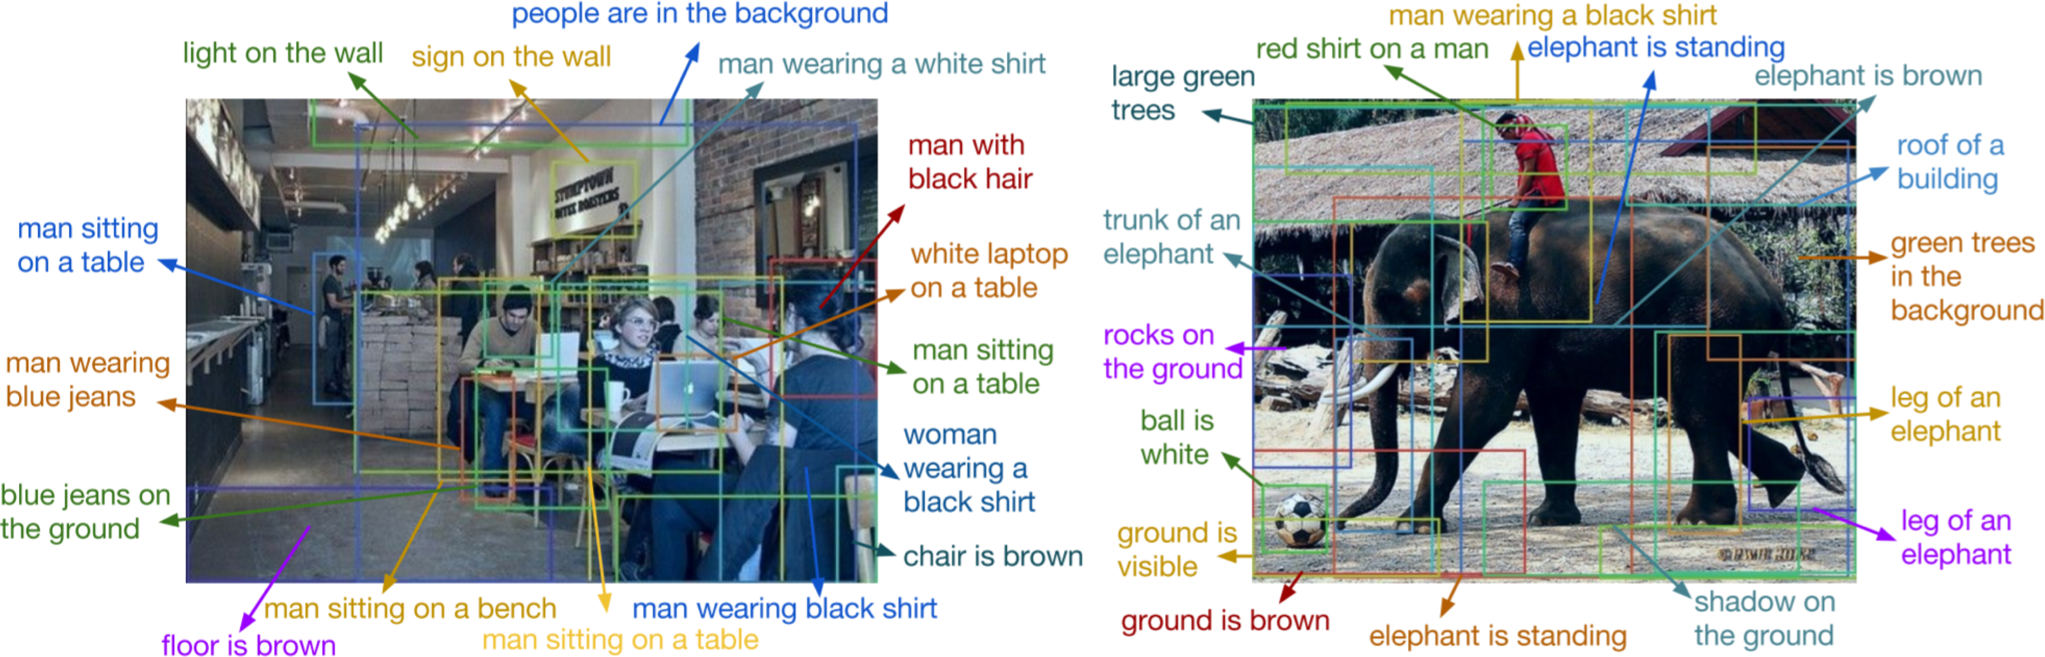
Dense Captioning

Slide 39
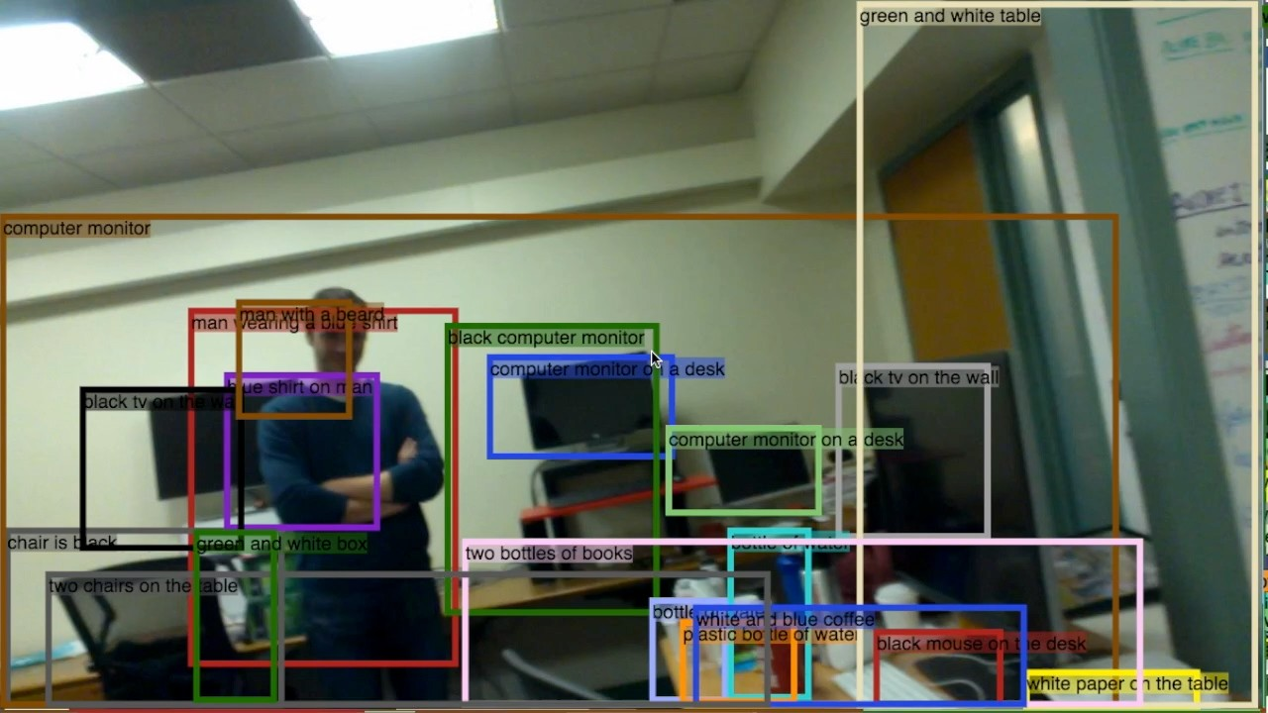
Dense Captioning

Slide 40
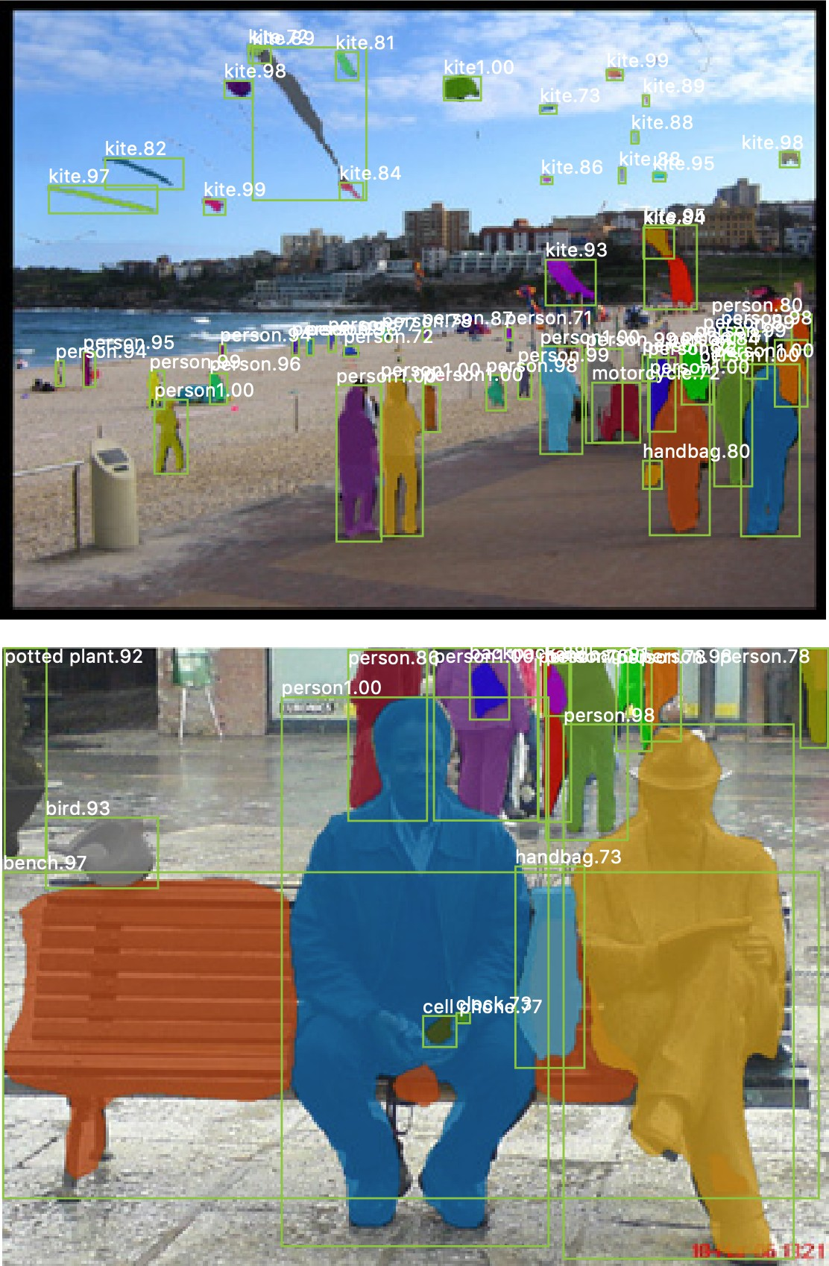
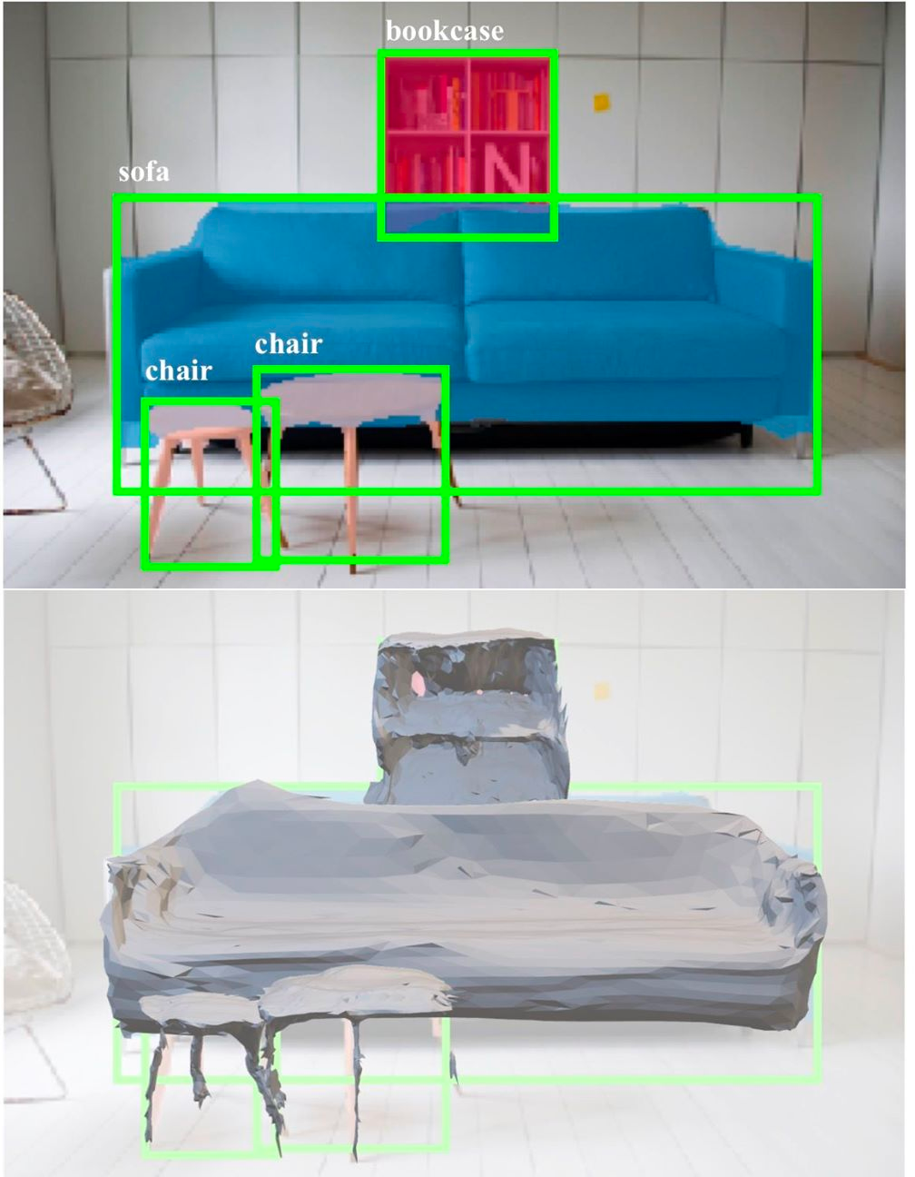
3D Shape Prediction: Mask R-CNN + Mesh Head
Mask R-CNN:
2D Image -> 2D shapes
Mesh R-CNN:
2D Image -> 3D shapes
More details next time!
He, Gkioxari, Dollár, and Girshick, “Mask R-CNN”, ICCV 2017
Gkioxari, Malik, and Johnson, “Mesh R-CNN”, ICCV 2019

Slide 41


